Slide 1
Web Technologies
Kamran
Lecture 7-8

Slide 2

Contents
CSS

Slide 3
CSS Introduction
Cascading Style Sheets (CSS)
Markup language, used to describe the presentation of document
Defines sizes, fonts, colors, layout, etc.
Improves content accessibility
Improves flexibility
Designed to separate presentation from content
Because of CSS all HTML presentation tags are deprecated, e.g. <font>, <center>, <b> etc.

Slide 4
Why “Cascading”?
Priority scheme determining which style rules apply to element
Cascade priorities or weights are calculated and assigned to the rules
Child elements in the HTML DOM tree inherit the styles from their parent
Can override them
Control via !important rule

Slide 5
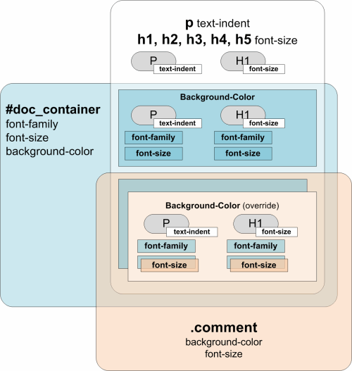
Why “Cascading”? (2)

Slide 6
Style Sheets Syntax
CSS has simple syntax, based on English words
Contains a set of cascading rules
Each rule consists of one or more selectors and declaration block
Declaration block consists of one or more semicolon-terminated declarations in curly braces
Declaration consists of property, a colon and value
h1,h2,h3,h4,h5,h6 { color: green }

Slide 7
Style Sheets Syntax (2)
Selectors determine which element the rule applies to:
All elements of specific type
Those that mach specific attribute
Elements may be matched depending on how they are nested in the document (HTML)
Examples:
h1 .title { color: green }
#menu li { padding-top: 8px }

Slide 8
Style Sheets Syntax (3)
Pseudo-classes define further behavior
Appended to a selector
:hover, :first-letter, :visited, :active, :before, :after
Not all browsers support them fully
a:link {text-decoration: none} a:visited {text-decoration: none} a:active {text-decoration: none} a:hover {text-decoration: underline; color: red}
.title:before { content: "»" }
.title:after { content: "«" }

Slide 9
Style Sheets Syntax (4)
Three primary types of selectors:
By tag:
By element id:
By element class name (only for HTML):
Selectors can be combined with commas:
This will match <h1> tags, elements with class link and element with id top-link
h1 {font-face: Verdana}
#element_id {color:#FF0000}
.class_name {border: 1px solid red}
h1, .link, #top-link {font-weight: bold}

Slide 10
Style Sheets Syntax (5)
Match relative to element placement:
This will match all <a> tags that are inside of <p>
* – universal selector:
This will match all child nodes of <p> tag
+ selector – used to match “the following” tag:
This will match all elements with class name link that appear immediately after <img> tag
p a {text-decoration: underline}
p * {color: black}
img + .link {float:right}

Slide 11
Style Sheets Syntax (5)
> selector – matches direct child nodes of element:
This will match all elements with class error, direct children of <p> tag
[ ] – match tag attributes by regular expression:
This will match all <img> tags with alt attribute containing the word logo
There are more rules to select attributes
Not well supported in all browsers
p > .error {font-size: 8px}
img[alt~=logo] {border: none}

Slide 12
Default Browser Styles
Browsers have default CSS styles
Used when there is no CSS information or any other style information in the document
Silently inherited in all documents
Caution: default styles differ in browsers
E.g. Firefox default page background is white, while IE7 uses about 5% gray background

Slide 13
Linking HTML and CSS
HTML (content) and CSS (presentation) can be linked in three ways:
Inline: the CSS rules in the style attribute
No selectors are needed
Embedded: in the HTML in <style> tag
External: CSS rules are in separate file
Usually a file with .css extension
Linked via <link rel="stylesheet" href=…> tag or @import directive in embedded CSS block

Slide 14
Linking HTML and CSS (2)
Inline styles have highest priority
Then are the embedded styles
External styles are last
Using external files is highly recommended
Simplify the HTML document
Benefit from browser's cache
Inline styles are about to be deprecated by the W3C

Slide 15
Inline Styles
Inline CSS styles
Individual element’s style defined using style attribute
Contains only declaration, no selectors:
Override any other styles
Apply to all descendant elements
Used for styles that are not needed anywhere else in the Web site
<p style="font-size:20pt; color: #0000FF">

Slide 16
Inline Styles: Example
inline-styles.html
<!DOCTYPE html PUBLIC "-//W3C//DTD XHTML 1.0 Transitional//EN" "http://www.w3.org/TR/xhtml1/ DTD/xhtml1-transitional.dtd">
<html xmlns="http://www.w3.org/1999/xhtml">
<head>
<title>Inline Styles</title>
</head>
<body>
<p>Here is some text</p>
<!--Separate multiple styles with a semicolon-->
<p style="font-size: 20pt">Here is some
more text</p>
<p style="font-size: 20pt;color:
#0000FF" >Even more text</p>
</body>
</html>

Slide 17
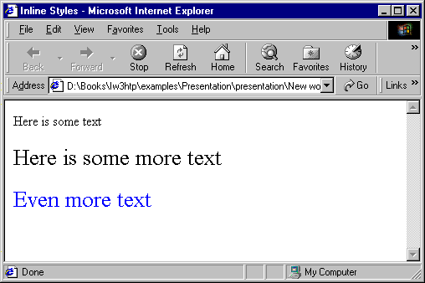
Inline Styles: Example
inline-styles.html
<!DOCTYPE html PUBLIC "-//W3C//DTD XHTML 1.0 Transitional//EN" "http://www.w3.org/TR/xhtml1/ DTD/xhtml1-transitional.dtd">
<html xmlns="http://www.w3.org/1999/xhtml">
<head>
<title>Inline Styles</title>
</head>
<body>
<p>Here is some text</p>
<!--Separate multiple styles with a semicolon-->
<p style="font-size: 20pt">Here is some
more text</p>
<p style="font-size: 20pt;color:
#0000FF" >Even more text</p>
</body>
</html>

Slide 18
CSS Rules Precedence
Inline CSS rules have precedence over the external CSS rules:
precedence.html
<!DOCTYPE html …>
<html xmlns="http://www.w3.org/1999/xhtml" >
<head>
<title>CSS Rules Precedence - Example</title>
<style type="text/css"> span {color:red} </style>
<link type="text/css" rel="stylesheet" href="" />
</head>
<body>
<span>Some text</span>
<span style="color:Blue">Some text</span>
</body>
</html>

Slide 19
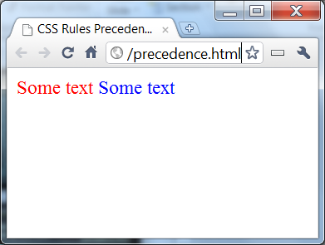
CSS Rules Precedence
Inline CSS rules have precedence over the external CSS rules:
precedence.html
<!DOCTYPE html …>
<html xmlns="http://www.w3.org/1999/xhtml" >
<head>
<title>CSS Rules Precedence - Example</title>
<style type="text/css"> span {color:red} </style>
<link type="text/css" rel="stylesheet" href="" />
</head>
<body>
<span>Some text</span>
<span style="color:Blue">Some text</span>
</body>
</html>

Slide 20
Embedded Styles
Embedded in the HTML in the <style> tag:
The <style> tag is placed in the <head> section of the document
Styles apply to the whole document
type attribute specifies the MIME type
MIME is a describes the format of the content
Other MIME types include text/html, image/gif, text/javascript …
Used for document-specific styles
<style type="text/css">
Notes:
The Multipurpose Internet Mail Extensions, known also as MIME type, is a specification extending the format of email to support sending images, audio/video files, archives, etc. The specification is standardized in IETF RFC 6838.

Slide 21
Embedded Styles: Example
embedded-stylesheets.html
<!DOCTYPE html PUBLIC "-//W3C//DTD XHTML 1.0 Transitional//EN" "http://www.w3.org/TR/xhtml1/DTD/xhtml1-transitional.dtd">
<html xmlns="http://www.w3.org/1999/xhtml">
<head>
<title>Style Sheets</title>
<style type="text/css">
em {background-color:#8000FF; color:white}
h1 {font-family:Arial, sans-serif}
p {font-size:18pt}
.blue {color:blue}
</style>
<head>

Slide 22
Embedded Styles: Example (2)
…
<body>
<h1 class="blue">A Heading</h1>
<p>Here is some text. Here is some text. Here
is some text. Here is some text. Here is some
text.</p>
<h1>Another Heading</h1>
<p class="blue">Here is some more text.
Here is some more text.</p>
<p class="blue">Here is some <em>more</em>
text. Here is some more text.</p>
</body>
</html>

Slide 23
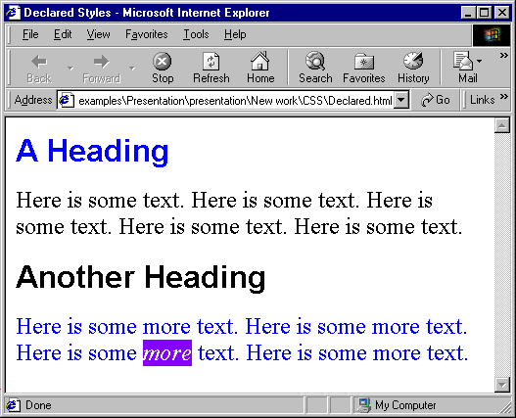
Embedded Styles: Example (3)
…
<body>
<h1 class="blue">A Heading</h1>
<p>Here is some text. Here is some text. Here
is some text. Here is some text. Here is some
text.</p>
<h1>Another Heading</h1>
<p class="blue">Here is some more text.
Here is some more text.</p>
<p class="blue">Here is some <em>more</em>
text. Here is some more text.</p>
</body>
</html>

Slide 24
External CSS Styles
External linking
Separate pages can all use shared style sheet
Only modify a single file to change the styles across your entire Web site
link tag (with rel attribute)
Specifies a relationship between current document and another document
link element can stay only in the HTML header
<link rel="stylesheet" type="text/css"
href="styles.css">

Slide 25
External CSS Styles (2)
@import
Another way to link external CSS files
Example:
Not all browsers recognize such rules
You can specify this way browser-specific styles (IE6 ignores the @import)
<style type="text/css">
@import url(styles.css);
</style>

Slide 26
External Styles: Example
styles.css
/* CSS Document */
a { text-decoration: none }
a:hover { text-decoration: underline;
color: red;
background-color: #CCFFCC }
li em { color: red;
font-weight: bold }
ul { margin-left: 2cm }
ul ul { text-decoration: underline;
margin-left: .5cm }

Slide 27
External Styles: Example (2)
external-styles.html
<!DOCTYPE html PUBLIC "-//W3C//DTD XHTML 1.0
Transitional//EN"
"http://www.w3.org/TR/xhtml1/DTD/xhtml1-transitional.dtd">
<html xmlns="http://www.w3.org/1999/xhtml">
<head>
<title>Importing style sheets</title>
<link type="text/css" rel="stylesheet"
href="styles.css" />
</head>
<body>
<h1>Shopping list for <em>Monday</em>:</h1>
<li>Milk</li>
…

Slide 28
External Styles: Example (3)
…
<li>Bread
<ul>
<li>White bread</li>
<li>Rye bread</li>
<li>Whole wheat bread</li>
</ul>
</li>
<li>Rice</li>
<li>Potatoes</li>
<li>Pizza <em>with mushrooms</em></li>
</ul>
<a href="http://food.com" title="grocery
store">Go to the Grocery store</a>
</body>
</html>

Slide 29
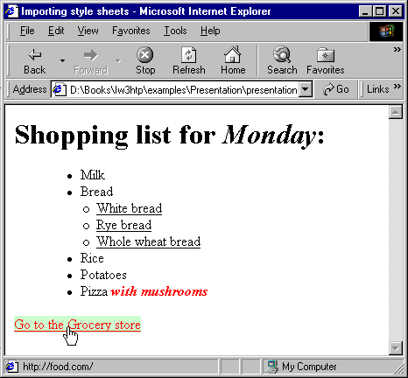
External Styles: Example (4)
…
<li>Bread
<ul>
<li>White bread</li>
<li>Rye bread</li>
<li>Whole wheat bread</li>
</ul>
</li>
<li>Rice</li>
<li>Potatoes</li>
<li>Pizza <em>with mushrooms</em></li>
</ul>
<a href="http://food.com" title="grocery
store">Go to the Grocery store</a>
</body>
</html>

Slide 30
Values in the CSS Rules
Colors are specified in RGB format, in hex form:
Example: #A0A6AA
Predefined color aliases exist: black, blue, etc.
Numeric values are specified in:
Pixels, e.g. 12px
Points, e.g. 10pt
Inches, centimeters, millimeters
E.g. 1in, 1cm, 1mm
Percentages, e.g. 50%
Percentage is relative to the parent element

Slide 31
CSS Rules for Fonts
color – specifies the color of the text
font-size – size of font: xx-small, x-small, small, medium, large, x-large, xx-large, smaller, larger or numeric value
font-family – comma separated font names
Example: Verdana, Sans-Serif, etc.
The browser loads the first one that is available
There should always be at least one serif font
font-weight – normal, bold, bolder, lighter or number in range [100 … 900]

Slide 32
CSS Rules for Fonts (2)
font-style – styles the font
Values: normal, italic, oblique
text-decoration – decorates the text
Values: none, underline, line-trough, overline, blink
text-align – defines the alignment of text or other content
Values: left, right, center, justify

Slide 33
Short Font Rules
font
Shorthand rule for setting multiple font properties at the same time
is equal to writing this:
font: italic normal bold 12px Verdana;
font-style: italic;
font-variant: normal;
font-weight: bold;
font-size:12px;
font-family: Verdana;

Slide 34
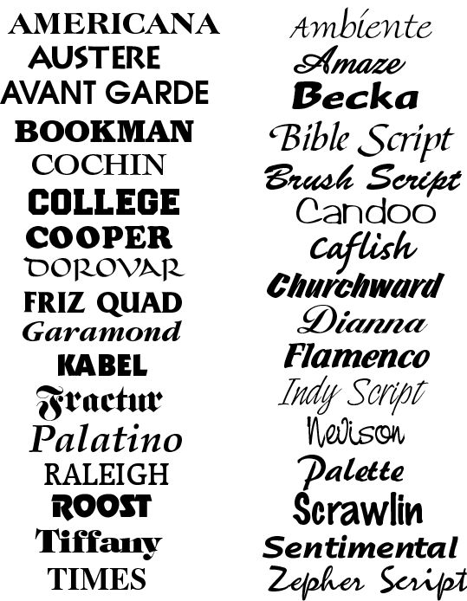




Fonts
Live Demo
font-rules.html

Slide 35
Background CSS Rules
background-color
Solid color background
background-image
URL of image to be used as background, e.g.:
background-repeat
repeat-x, repeat-y, repeat, no-repeat
background-attachment
fixed / scroll
background-image:url("back.gif");

Slide 36
Background CSS Rules (2)
background-position: specifies vertical and horizontal position of the background image
Vertical position: top, center, bottom
Horizontal position: left, center, right
Both can be specified in percentage or other numerical values
Examples:
background-position: top left;
background-position: -5px 50%;

Slide 37
Background Short Rule
background: shorthand rule for setting background properties at the same time:
is equal to writing:
Some browsers will not apply BOTH color and image for background if using shorthand rule
background: #FFF0C0 url("back.gif") no-repeat fixed top;
background-color: #FFF0C0;
background-image: url("back.gif");
background-repeat: no-repeat;
background-attachment: fixed;
background-position: top;

Slide 38
Background-image or <img>?
Background images allow you to save many image tags from the HTML
Leads to less code
More content-oriented approach
All images that are not part of the page content should be moved to the CSS

Slide 39
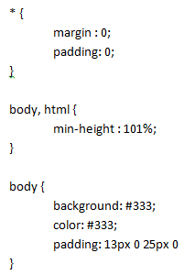

Background Styles
Live Demo
background-rules.html

Slide 40
Border CSS Rules
border-width: thin, medium, thick or numerical value (e.g. 10px)
border-color: color alias or RGB value
border-style: none, hidden, dotted, dashed, solid, double, groove, ridge, inset, outset
Each property can be defined separately for left, top, bottom and right
border-top-style, border-left-color, …

Slide 41
Border Short Rules
border: shorthand rule for setting border properties at once:
is equal to writing:
Specify different borders for the sides via shorthand rules: border-top, border-left, border-right, border-bottom
border: 1px solid red;
border-width:1px;
border-color:red;
border-style:solid;

Slide 42
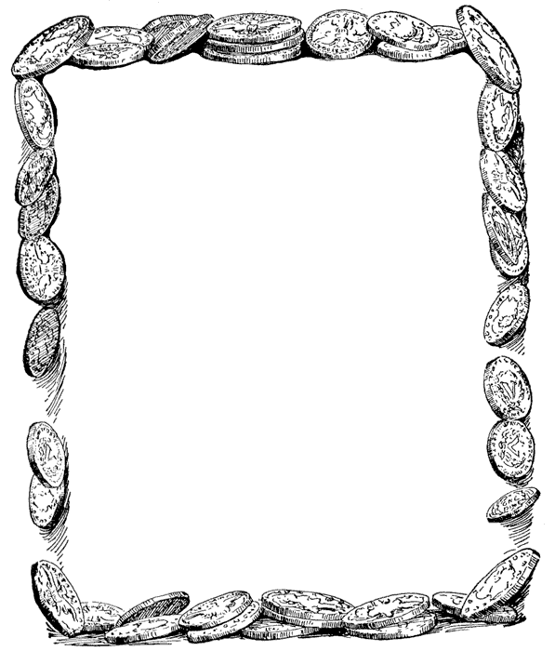
Borders
Live Demo
border-rules.html

Slide 43
Width, Height CSS Rules
width – defines numerical value for the width of element, e.g. 200px
height – defines numerical value for the height of element, e.g. 100px
Important: not all elements and browsers follow this value!
Usually the height of an element is defined by its content
Common mistake is to apply height to tables or table cells

Slide 44
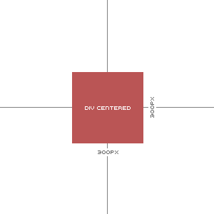
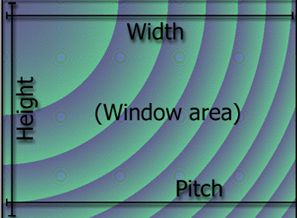
Width / Height
Live Demo
size-rules.html

Slide 45
Margin and Padding
margin and padding define the spacing around the element
Numerical value, e.g. 10px or -5px
Can be defined for each of the four sides separately
margin-top, padding-left, …
margin is the spacing outside of the border
padding is the spacing between the border and the content

Slide 46
Margin and Padding: Short Rules
margin: 5px;
Sets all four sides to have margin of 5 px;
margin: 10px 20px;
Sets margins: top and bottom to 10px, left and right to 20px;
margin: 1px 3px 5px 7px;
Sets top, right, bottom, left margins to 1px, 3px, 5px and 7px respectively
Same shorthand rules apply for padding

Slide 47
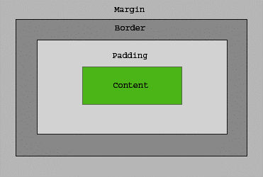
The Box Model

Slide 48
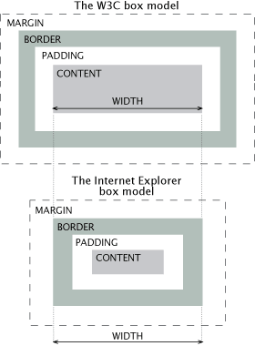
Gecko and W3C vs. IE
Major difference between browsers when applying border, padding and width/height
To avoid you need either “CSS hacks” or just don’t specify for the same element width/height and padding or border, different than 0

Slide 49

Margins and Paddings
Live Demo
margins-paddings-rules.html

Slide 50
CSS Rules for Positioning
position: defines the positioning of the element, depending on the parent elements
The value is one of:
static (default)
relative – relative position according to where the element would appear with static position
absolute – position according the parent element
fixed – fix element on screen, ignore page scrolling

Slide 51
CSS Rules for Positioning (2)
Fixed and absolute positioned elements “float” over the rest of elements
Moved to separate document layer
Their position and size is ignored when calculating the size of parent element or position of surrounding elements
Ordered by their z-index

Slide 52


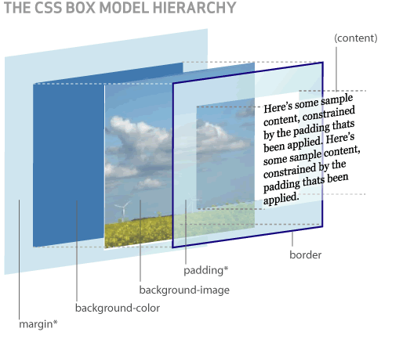
Positioning
Live Demo
positioning-rules.html

Slide 53
CSS Rules for Positioning
top, left, bottom, right: specifies offset of absolute/fixed/relative positioned element as numerical values
vertical-align: sets the vertical-alignment of an element
Usually used for table cells
Values: baseline, sub, super, top, text-top, middle, bottom, text-bottom or numeric
z-index: specifies the depth-order of element

Slide 54
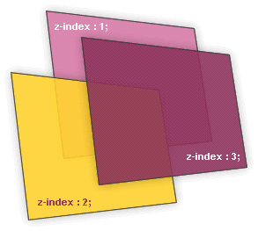

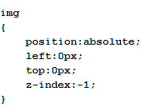
Alignment and Z-Index
Live Demo
alignments-and-z-index-rules.html

Slide 55
Float CSS Rule
float: the element “floats” above the elements
similar to position: absolute and the align HTML property of <img> tag
element is taken into account when rendering the surrounding text and elements
left: places the element on the left
right: places the element on the right

Slide 56
Clear CSS Rule
clear
Sets the sides of the element where other floating elements are NOT allowed
Possible values: left, right, both
This rule can be applied only to “floating” elements

Slide 57


Floating Elements
Live Demo
float-rules.html

Slide 58
Opacity CSS Rule
opacity: specifies the opacity of the element
Floating point number from 0 to 1
Supported only by Safari browser
For Mozilla use –moz-opacity CSS rule
For IE use filter:alpha(opacity=value) where value is from 0 to 100
Need to apply all three rules

Slide 59
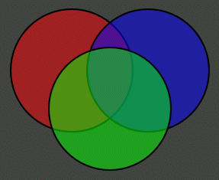
Opacity
Live Demo
opacity-rule.html

Slide 60
Visibility CSS Rule
visibility
Determines whether the element is visible
hidden: element is not rendered, but still takes place in the rendering (acts like opacity:0)
visible: element is rendered normally

Slide 61

Visibility
Live Demo
visibility-rule.html

Slide 62
Display CSS Rule
display: controls the display of the element and the way it is rendered and if breaks should be placed before and after the element
inline: no breaks are placed before and after (<span> is inline element)
block: breaks are placed before AND after the element (<div> is block element)

Slide 63
Display CSS Rule (2)
none: element is hidden and its dimensions are not used to calculate the surrounding elements rendering (differs from visibility: hidden!)
There are some more possible values, but not all browsers support them
Specific displays like table-cell and table-row

Slide 64

Display
Live Demo
display-rule.html

Slide 65
Overflow CSS Rule
overflow: defines the behavior of element when content needs more space than you have specified by the size properties or for other reasons. Values:
visible (default) – element size is increased to make space for content or the content “overflows” out of the element
scroll – show horizontal/vertical scroll bar in the element
hidden – any content in the element that cannot be placed inside is hidden

Slide 66

Overflow
Live Demo
overflow-rule.html

Slide 67
Other CSS Rules
cursor: specifies the look of the mouse cursor when placed over the element
Values: crosshair, help, pointer, progress, move, hair, col-resize, row-resize, text, wait, copy, drop, and others
white-space – controls the line breaking of text. Value is one of:
nowrap – keeps the text on one line
normal (default) – browser decides whether to brake the lines if needed

Slide 68
Benefits of using CSS
More powerful formatting than using presentation tags
Your pages load faster, because browsers cache the .css files
Increased accessibility, because rules can be defined according given media
Pages are easier to maintain and update

Slide 69
Maintenance Example
Title
Some random text here. You can’t read it anyway! Har har har! Use Css.
Title
Some random text here. You can’t read it anyway! Har har har! Use Css.
Title
Some random text here. You can’t read it anyway! Har har har! Use Css.
Title
Some random text here. You can’t read it anyway! Har har har! Use Css.
Title
Some random text here. You can’t read it anyway! Har har har! Use Css.
Title
Some random text here. You can’t read it anyway! Har har har! Use Css.
Title
Some random text here. You can’t read it anyway! Har har har! Use Css.
Title
Some random text here. You can’t read it anyway! Har har har! Use Css.
Title
Some random text here. You can’t read it anyway! Har har har! Use Css.
Title
Some random text here. You can’t read it anyway! Har har har! Use Css.
Title
Some random text here. You can’t read it anyway! Har har har! Use Css.
Title
Some random text here. You can’t read it anyway! Har har har! Use Css.
Title
Some random text here. You can’t read it anyway! Har har har! Use Css.
Title
Some random text here. You can’t read it anyway! Har har har! Use Css.
Title
Some random text here. You can’t read it anyway! Har har har! Use Css.
Title
Some random text here. You can’t read it anyway! Har har har! Use Css.
Title
Some random text here. You can’t read it anyway! Har har har! Use Css.
Title
Some random text here. You can’t read it anyway! Har har har! Use Css.
Title
Some random text here. You can’t read it anyway! Har har har! Use Css.
Title
Some random text here. You can’t read it anyway! Har har har! Use Css.
Title
Some random text here. You can’t read it anyway! Har har har! Use Css.
Title
Some random text here. You can’t read it anyway! Har har har! Use Css.
Title
Some random text here. You can’t read it anyway! Har har har! Use Css.
one CSS file
Title
Some random text here. You can’t read it anyway! Har har har! Use Css.
Title
Some random text here. You can’t read it anyway! Har har har! Use Css.
Title
Some random text here. You can’t read it anyway! Har har har! Use Css.
Title
Some random text here. You can’t read it anyway! Har har har! Use Css.
Title
Some random text here. You can’t read it anyway! Har har har! Use Css.
Title
Some random text here. You can’t read it anyway! Har har har! Use Css.
Title
Some random text here. You can’t read it anyway! Har har har! Use Css.
Title
Some random text here. You can’t read it anyway! Har har har! Use Css.
Title
Some random text here. You can’t read it anyway! Har har har! Use Css.
Title
Some random text here. You can’t read it anyway! Har har har! Use Css.
Title
Some random text here. You can’t read it anyway! Har har har! Use Css.
Title
Some random text here. You can’t read it anyway! Har har har! Use Css.
Title
Some random text here. You can’t read it anyway! Har har har! Use Css.
Title
Some random text here. You can’t read it anyway! Har har har! Use Css.
Title
Some random text here. You can’t read it anyway! Har har har! Use Css.
Title
Some random text here. You can’t read it anyway! Har har har! Use Css.
Title
Some random text here. You can’t read it anyway! Har har har! Use Css.
Title
Some random text here. You can’t read it anyway! Har har har! Use Css.
Title
Some random text here. You can’t read it anyway! Har har har! Use Css.
Title
Some random text here. You can’t read it anyway! Har har har! Use Css.
Title
Some random text here. You can’t read it anyway! Har har har! Use Css.
Title
Some random text here. You can’t read it anyway! Har har har! Use Css.
Title
Some random text here. You can’t read it anyway! Har har har! Use Css.
Title
Some random text here. You can’t read it anyway! Har har har! Use Css.
Title
Some random text here. You can’t read it anyway! Har har har! Use Css.
Title
Some random text here. You can’t read it anyway! Har har har! Use Css.
Title
Some random text here. You can’t read it anyway! Har har har! Use Css.
Title
Some random text here. You can’t read it anyway! Har har har! Use Css.
Title
Some random text here. You can’t read it anyway! Har har har! Use Css.
Title
Some random text here. You can’t read it anyway! Har har har! Use Css.
Title
Some random text here. You can’t read it anyway! Har har har! Use Css.
Title
Some random text here. You can’t read it anyway! Har har har! Use Css.
Title
Some random text here. You can’t read it anyway! Har har har! Use Css.
Title
Some random text here. You can’t read it anyway! Har har har! Use Css.
Title
Some random text here. You can’t read it anyway! Har har har! Use Css.
Title
Some random text here. You can’t read it anyway! Har har har! Use Css.

Slide 70
What to Avoid
Don’t use <font> or other presentation tags to change the look of your text
<font color=...>
<b>text that is bold
<center> this text is centered
Do not use complex CSS rules-sets because may slow down page rendering
Move as much as possible to external files
Avoid inline CSS

Slide 71
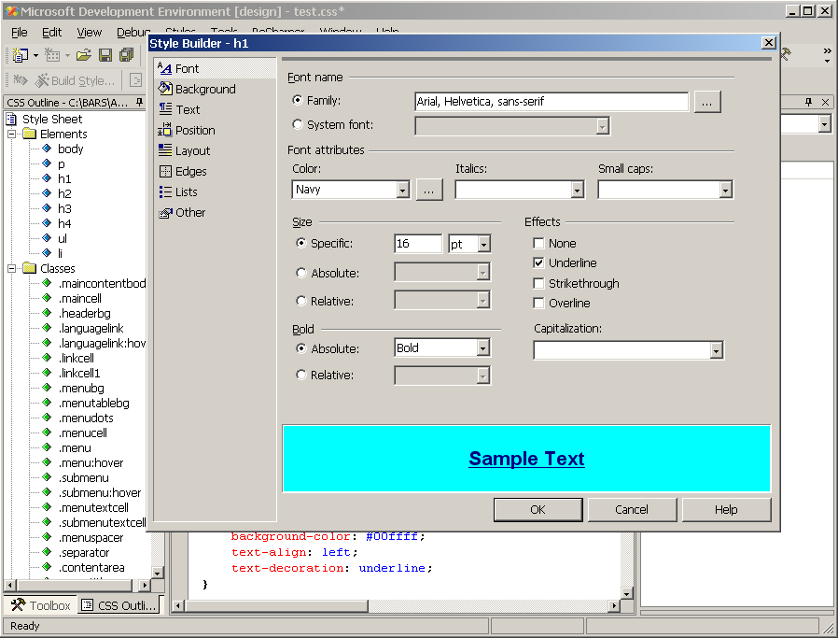
CSS Development Tools
Visual Studio – CSS Editor

Slide 72
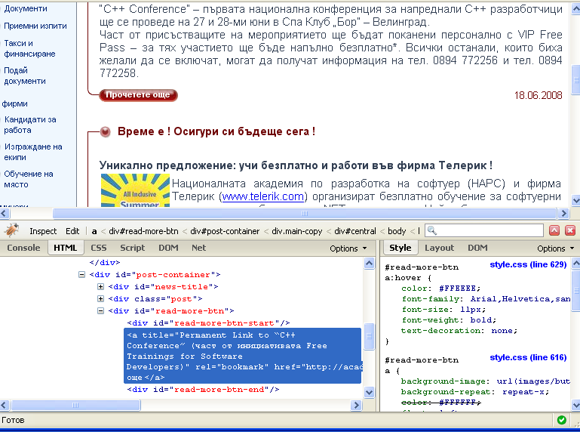
CSS Development Tools (2)
Firebug – add-on to Firefox used to examine and adjust CSS and HTML

Slide 73
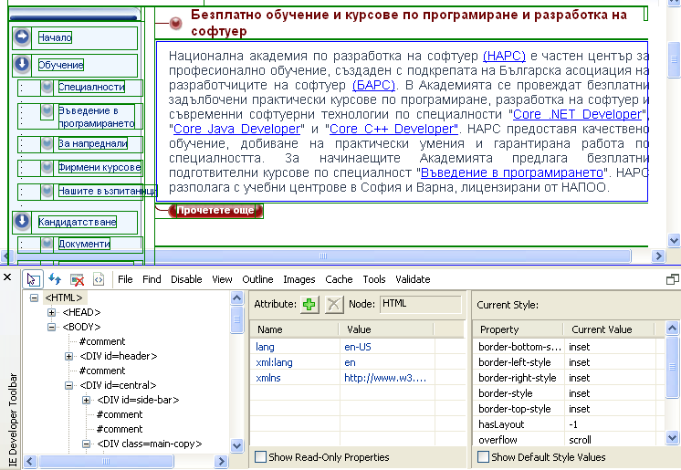
CSS Development Tools (3)
IE Developer Toolbar – add-on to IE used to examine CSS and HTML (press [F12])

Slide 74
HTML – Tables and Forms
?
?
?
?
?
Questions?
?
?
?
?
?
http://academy.telerik.com

